Slide 1
Estimating parameters of Astronomical signals

Slide 2
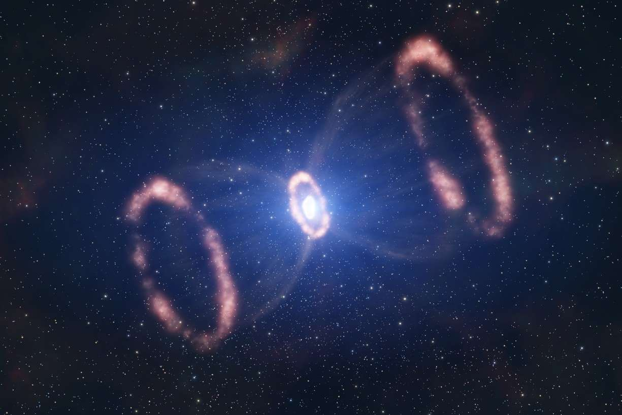
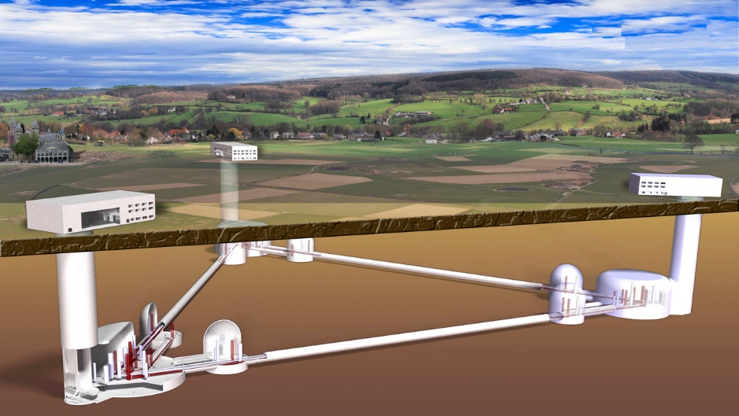
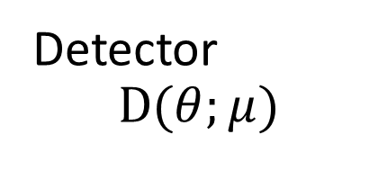
Astrophysical Phenomenon
Signal
Timeseries
Frequency series
Detector
$$D(θ;μ)$$
Not only signal; we get signal + noise: because:
Sensitivity limit; Brownian noise; not infinite precision
https://cdn.futura-sciences.com/buildsv6/images/largeoriginal/a/9/4/a940132305_50034136_supernova1987a.jpg
https://www.science.org/content/article/european-plan-gigantic-new-gravitational-wave-detector-passes-milestone

Slide 3
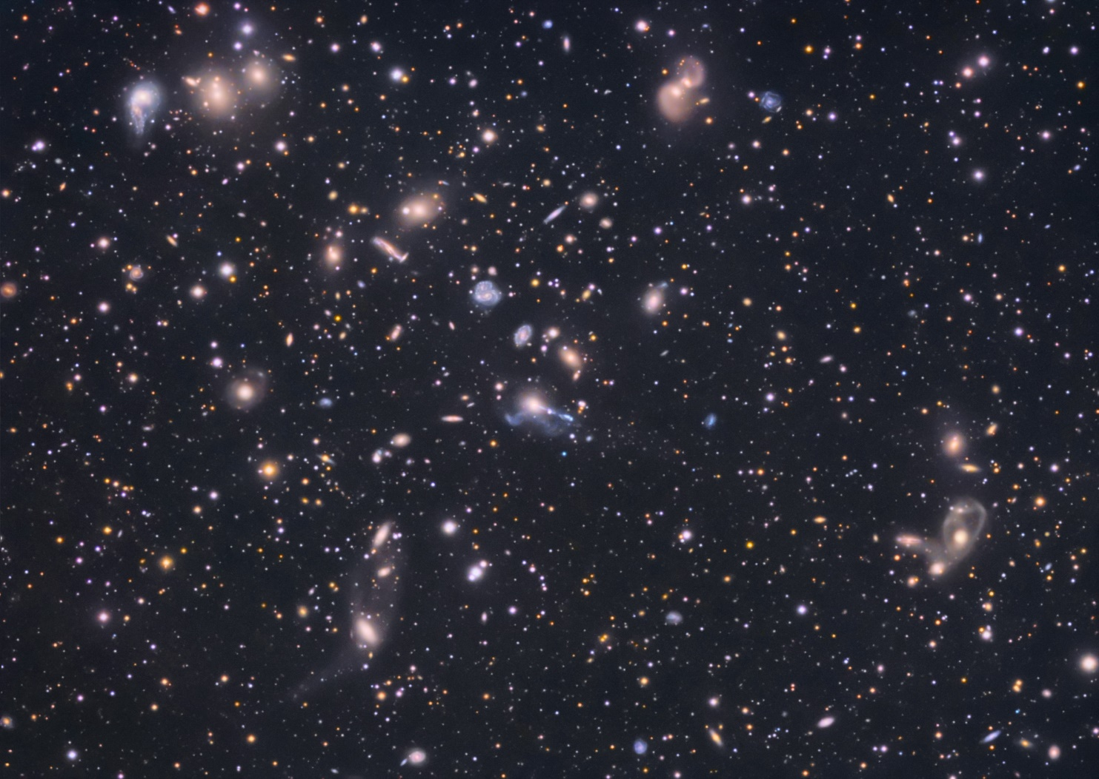
http://www.astronet.ru/db/xware/msg/apod/2009-07-16
How to know in the signal there is actual signal
I can see there is a signal
Keep looking the same segment for 10 mins: Is it actually a signal or am I looking for too long ?
A single snapshot does not tell any evolution so it is always a sequential data wrt time/space/freq, other param

Slide 4
How to know what parameters govern such SNR
More scientific way to look at the data
SNR
Validation of signal using cross-correlation etc etc.
For a signal there can be many parameter which result in the same SNR
One way is matching it with the Numerical signal but not always possible since exotic signals are left out or the parameter space is too large to vary and match.
Parameter estimation techniques

Slide 5
Parameter Estimation using Bayesian Inference
Bayesian inference is a method in which we use Bayes’ Theorem to update our understanding of a probability or a parameter as we gather more data and evidence
In most practical applications, computing the posterior distribution directly is not possible, this is why we employ numerical sampling techniques like MCMC.

Slide 6
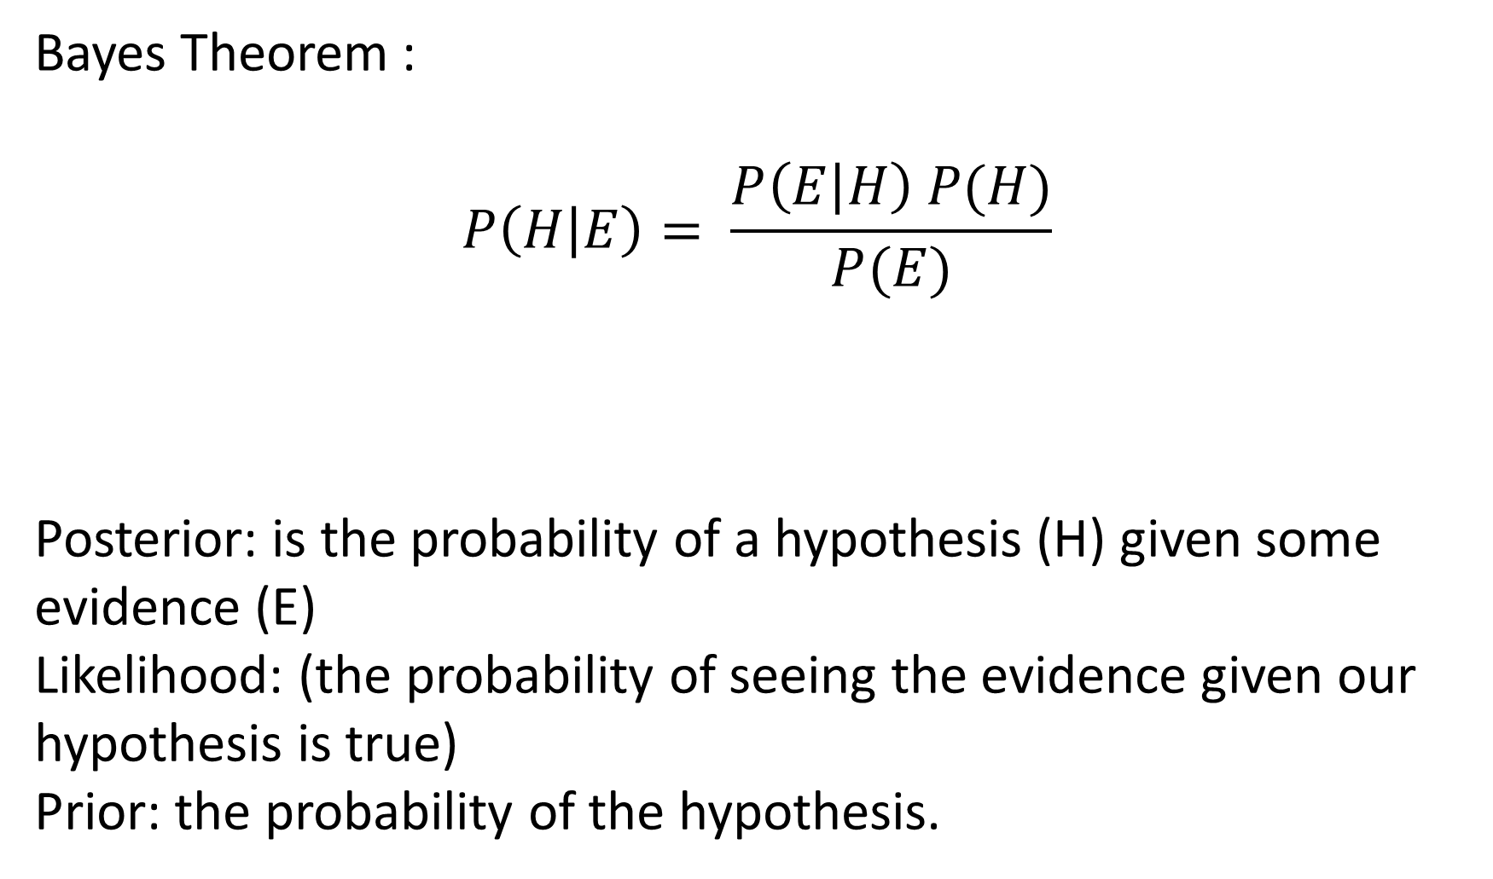
Bayes Theorem :
$$P\left(H | E\right)= \frac{P\left(E | H\right) P(H)}{P(E)}$$
Posterior: is the probability of a hypothesis (H) given some evidence (E)
Likelihood: (the probability of seeing the evidence given our hypothesis is true)
Prior: the probability of the hypothesis.
Likelihood
Prior
posterior
Probability corresponds to finding the chance of something given a sample distribution of the data, while on the other hand, Likelihood refers to finding the best distribution of the data given a particular value of some feature or some situation in the data.
marginal likelihood / evidence

Slide 7
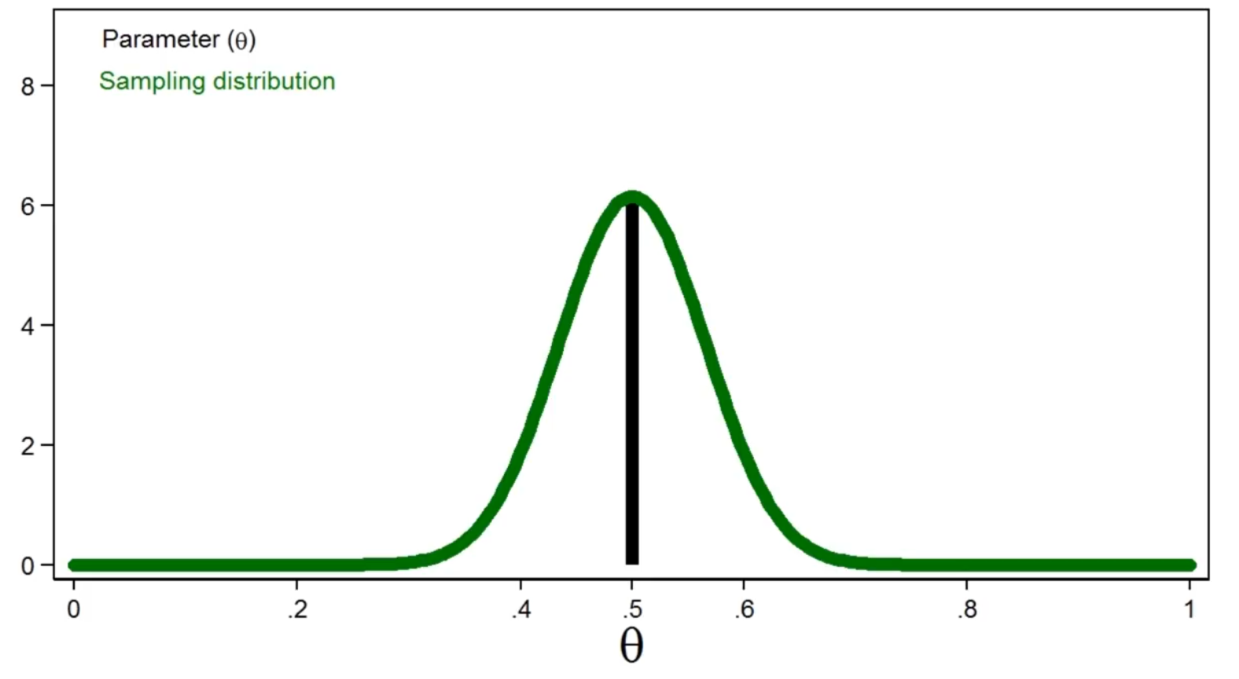
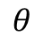
How parameters are actually estimated : Insight..
Parameter is physically a fixed parameter but measurement upto inf precision not possible
Generate random samples to estimate these parameters which will depend on the population itself
Bayesian approach describes the parameter as the random variable that can be defined over the space in terms of the probability of the samples .
$$θ$$

Slide 8


Markov chain Monte Carlo (MCMC)
Markov chain
Assumption is P(W_t | W_{t-1}) each number generated is dependent on previous number.
Events
Subspace
{
}
Matrix
0.7
0.3
0.5
0.3 | 0.7
0.5 | 0.5
0.5

Slide 9
Markov chain
W1 | W2 | W3 | W4 | W5
1.0 | 0.3 | 0.44 | .. | ..
0.0 | 0.7 | 0.56 | .. | ..
Steady state
P1
..
..
..
..
P2
We assume that the system will attain eqb state and marov chain will become steady
Generally N x N matrix to solve
Eg monopoly game

Slide 10
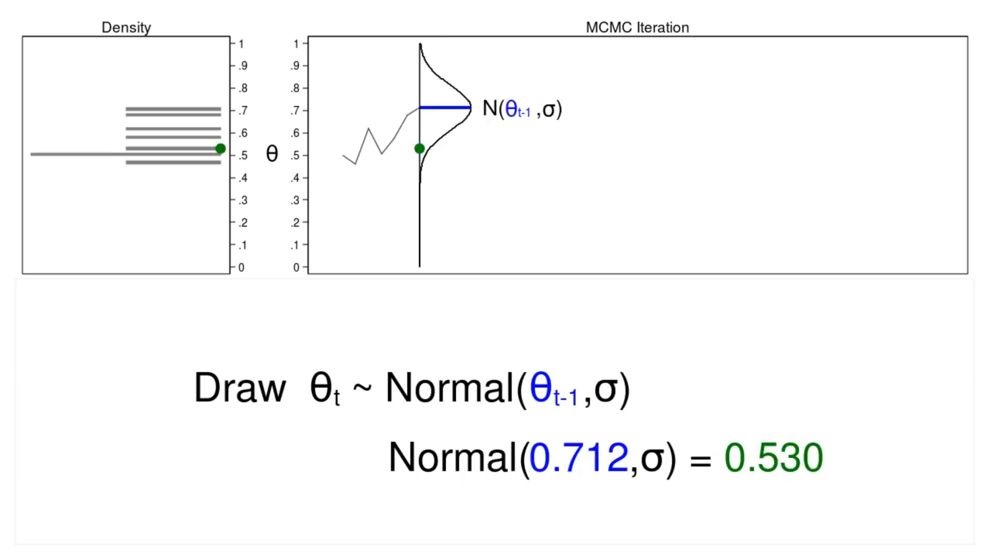
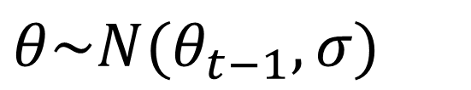
Markov chain
$θ\sim N(θ_{t−1}, σ)$

Slide 11
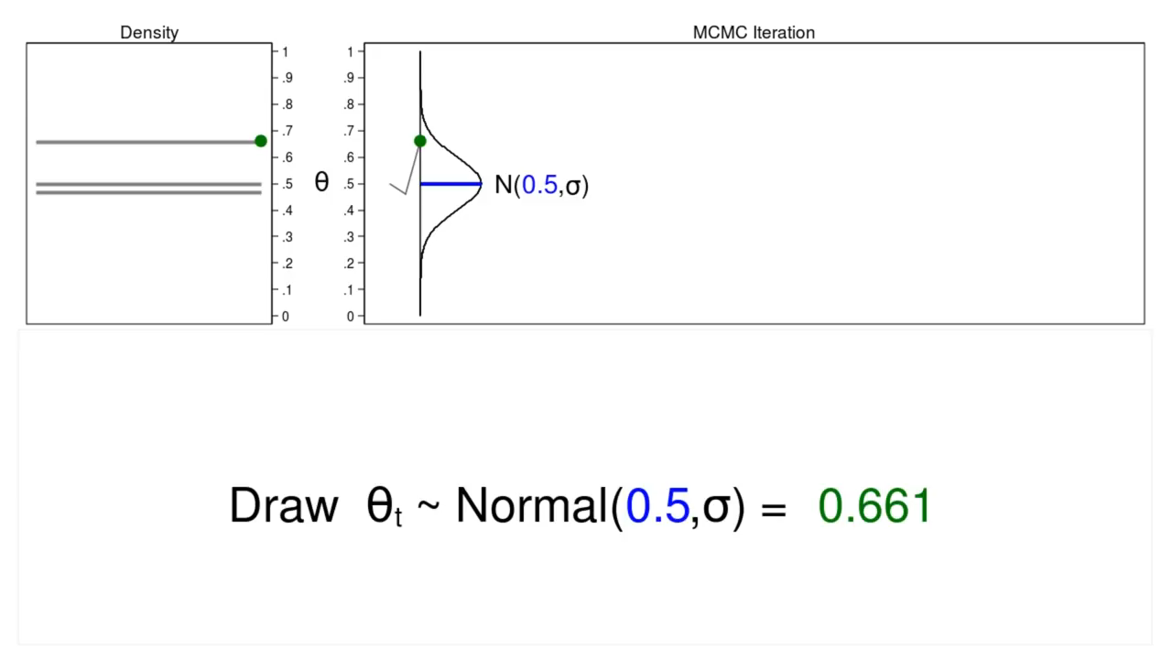
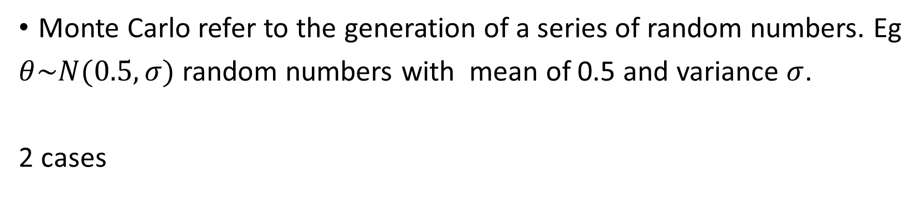
Monte Carlo
Monte Carlo refer to the generation of a series of random numbers. Eg
$θ\sim N(0.5, σ)$ random numbers with mean of 0.5 and variance $σ$.
2 cases

Slide 12
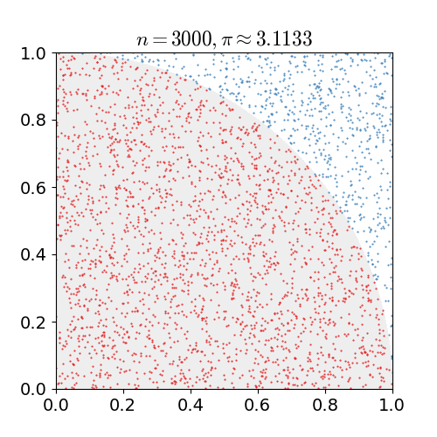
Eg of random balls falling in the square plate to circle and find pi
As points are randomly scattered inside the unit square, some fall within the unit circle. The fraction of points inside the circle over all points approaches pi/4 as the number of points goes toward infinity. This animation represents this method of computing pi out to 30,000 iterations.
https://en.wikipedia.org/wiki/File:Pi_30K.gif

Slide 13
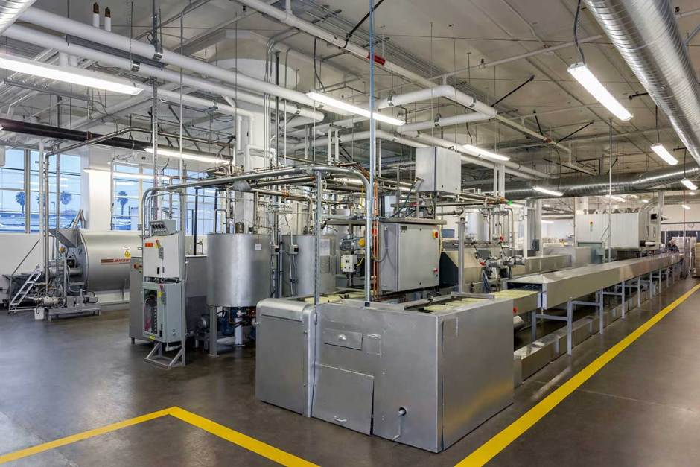
Eg of coin flip to employ MCMC methods
model the probability of the outcome of a coin flip but in an expanded context
Measure the coin’s ‘bias’.
Each coin will have its own bias, but given they are produced in the same process and vary only slightly, we expect the factory to produce coins not randomly, but around a ‘factory bias’.
We will use both information from the specific coin and the factory bias to create a probability distribution to determine the bias a coin is most likely produced with.
In Bayes’ terms, we will use the likelihood (coin data) and the prior (factory bias) to produce the posterior distribution for the coin bias.

Slide 14
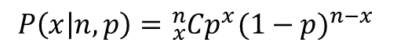
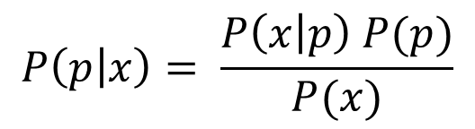
It is the probability, P, that the factory produces a coin with bias, p, given our data, x number of heads — P(p|x). The rest of the theorem can be written as follows:
$$P\left(p | x\right)= \frac{P\left(x | p\right) P(p)}{P(x)}$$
The likelihood function here is the probability of observing a heads, x, given a coin with bias p
$$P\left(x | n,p\right)={}_{x}^{n}{Cp^{x}{(1−p)}^{n−x}}$$
It is important to note that we do not currently know the value p for a given coin. This value is the one our MCMC will randomly sample. After initializing p with a random. value, and through many samples, the model will converge towards the true value of p.
So, we run an experiment with this first coin by flipping it 100 times and recording the number of times it landed on heads — 57 times so x becomes 57.
We implemented using Metropolis-Hastings algorithm.

Slide 15
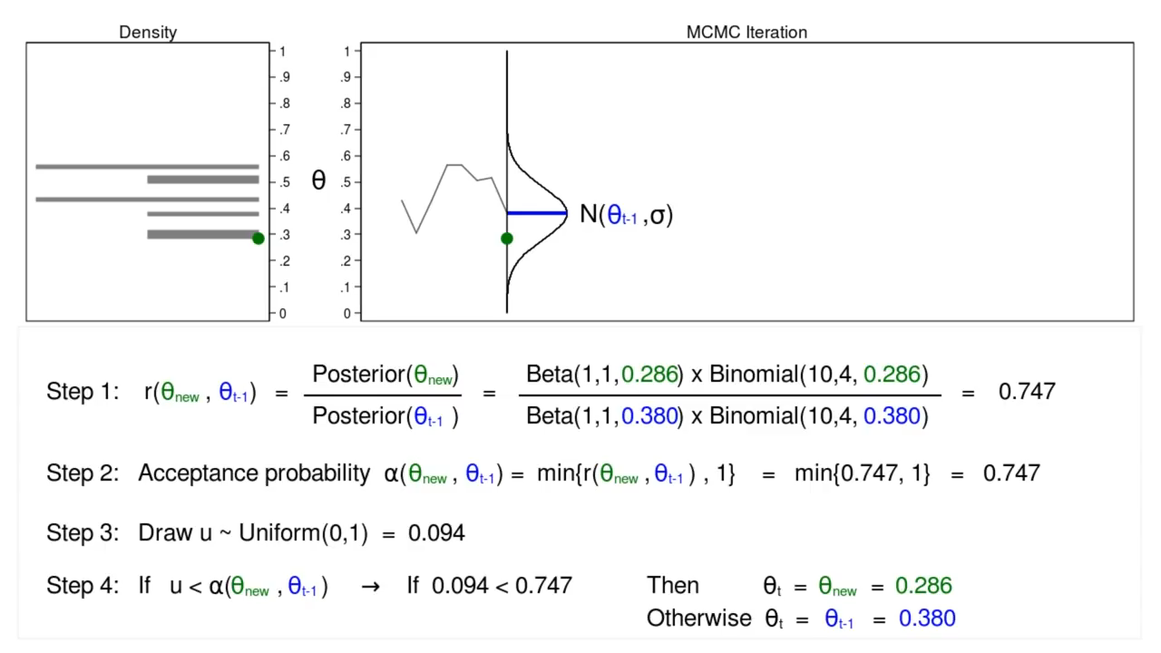
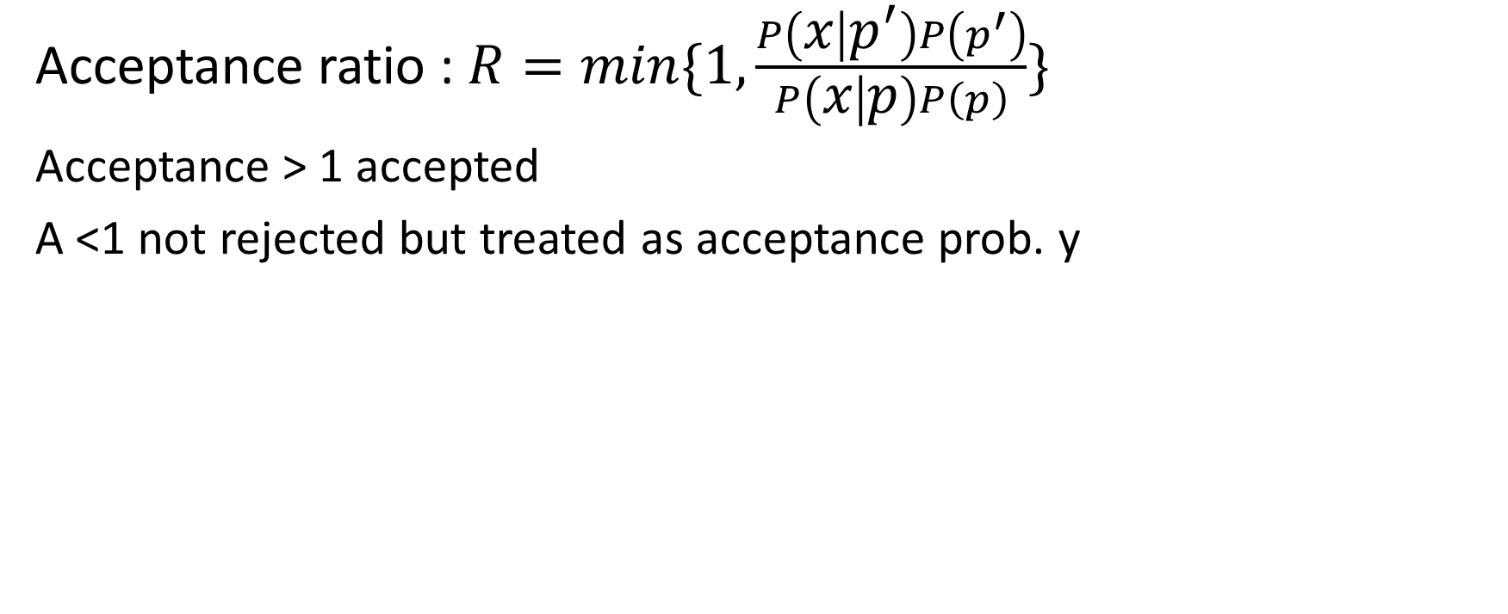
Metropolis-Hastings algorithm
Acceptance ratio : $R=min\{1,\frac{P\left(x | p^{′}\right)P\left(p^{′}\right)}{P\left(x | p\right)P\left(p\right)}\}$
Acceptance > 1 accepted
A <1 not rejected but treated as acceptance prob. y

Slide 16
Sampling Algorithm
We have already defined our functions for the likelihood, prior, and acceptance probability. The last thing we must do before looping is to initialize p with a random value within its range, 0 to 1.
Here are the steps of our Metropolis-Hastings algorithm:
Propose a new value of p randomly between 0 and 1, call it p′ (or p_new).
Compute the acceptance ratio, R.
Generate another uniform random number between 0 and 1, call it u.
If u < R, accept the new value and set p = p′. Otherwise, keep the current value of p.
Record the final value of p for this sample.
Repeat steps 1 through 5 many, many times.
Pretty straightforward. Before we code this up, let’s explore a couple of other common concepts utilized in MCMC.
Burn-in
MCMCs are initialized randomly and must converge towards the correct value, and this can often take quite a lot of samples. When plotting our results and posterior distribution, it is not effective to include these early samples before the model has converged. So we implement what is called a “burn-in”, in which those first, less accurate samples are excluded. Burn-in for MCMCs is typically around 2000–5000 samples when the entire chain is around 10k–20k.

Slide 17
Eg using a library
Create a dummy dataset
Create a log likelihood function p(y|x,σ,m,b,f) …
Create a posterior prob = p(m,b,f|x,y,σ)∝p(m,b,f) p(y|x,σ,m,b,f)
Optimize the function ⬄ maximize the likelihood ⬄ minimizing the negative likelihood
Define priors p(m,b,f)
Simulate !!
Why log likelihood and not simply likelihood…? Think in terms of properties of log and fast increasing values Joint distribution and Gaussian ex
https://math.stackexchange.com/questions/892832/why-we-consider-log-likelihood-instead-of-likelihood-in-gaussian-distribution

Slide 18
Real life examples
Radial velocity examples
Gravitational wave detection

